Slide 1
Ch.1 An Intro to Programming
Marjon Santiago

Slide 2
What will I be teaching you?
Java
Object-Oriented Programming
Some CS “stuff”
Anything else that I feel will be relevant

Slide 3

What will I NOT be teaching you?
How to get a 5 on the AP CS Exam
What NFTs and Cryptocurrencies you should buy
How to speed hack/build hack in Fortnite
How to get a girlfriend or boyfriend

Slide 4


What is a Computer?
“It is a magic box that lets you play Fortnite.”
- Alan Turing, father of Computer Science, circa 1942

Slide 5
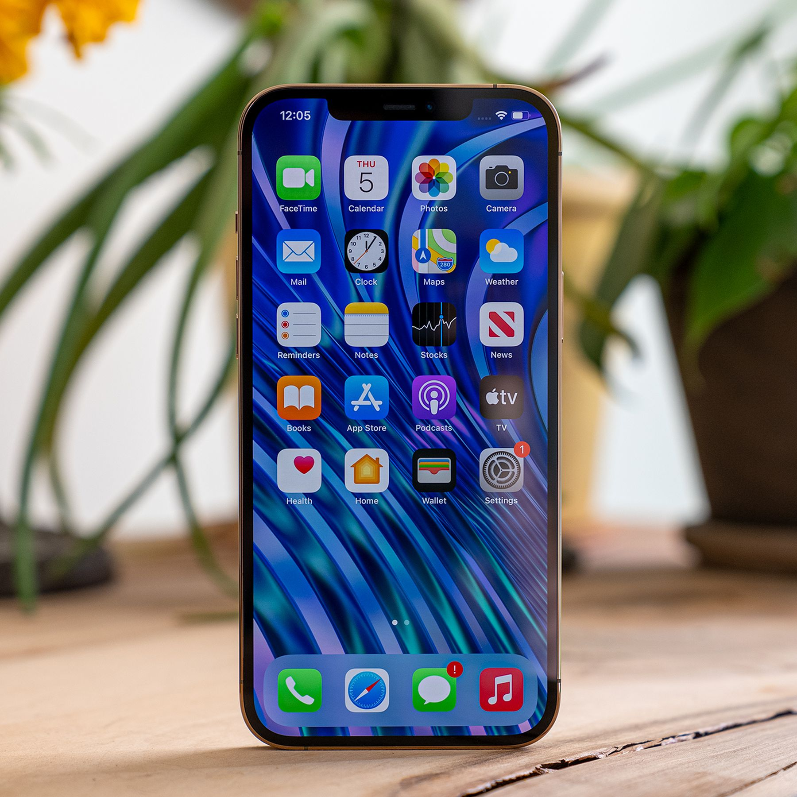
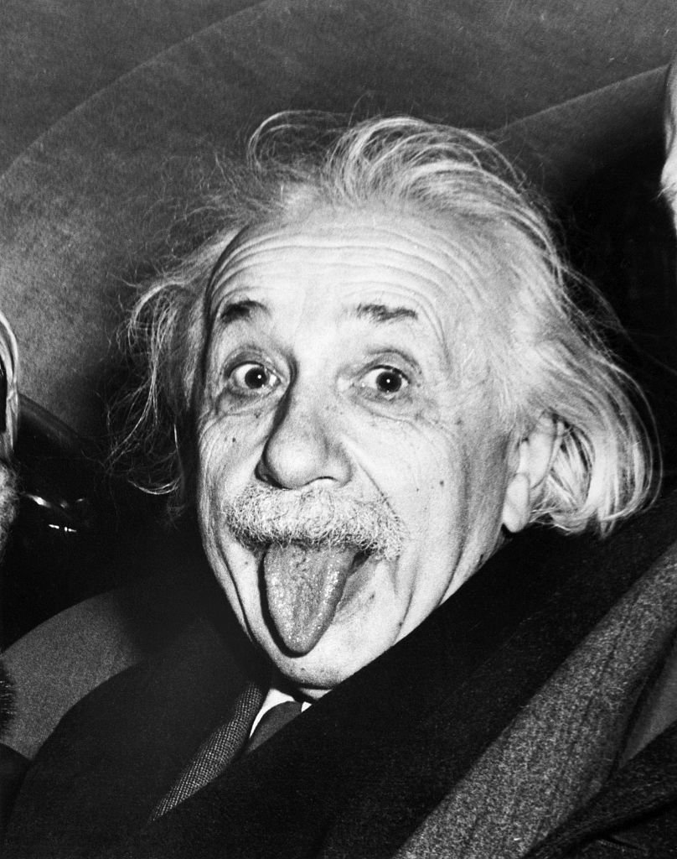

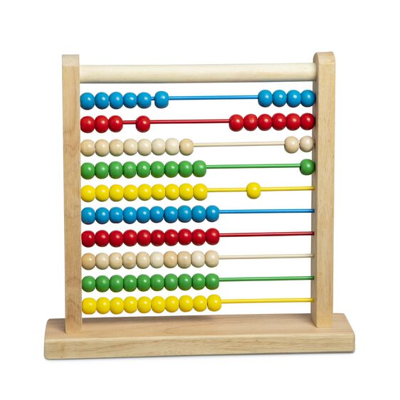

Are these Computers?

Slide 6

The Answer is…
Only the phone and the Nintendo Switch are computers.
Remember that a computer, by definition, can let you play Fortnite.
The thermometer, the abacus, and Albert Einstein do not let you play Fortnite.

Slide 7

The Truth is…
I lied!
A computer doesn’t have to let you play Fortnite to be considered a computer.

Slide 8
They are ALL Computers
Computer – Something that takes an input, performs a computation, and spits out an output.
Two major classifications of Computers:
Digital – dealing with discrete values (1s and 0s)
Analog – dealing with continuous values as input

Slide 9
Classification
Digital
?
Analog
Notes:
https://news.yale.edu/2006/04/12/brain-communicates-analog-and-digital-modes-simultaneously
New Haven, Conn. — Contrary to popular belief, brain cells use a mix of analog and digital coding at the same time to communicate efficiently, according to a study by Yale School of Medicine researchers published this week in Nature.
This finding partially overturns a longstanding belief that each of the brain’s 100 billion neurons communicate strictly by a digital code. Analog systems represent signals continuously, while digital systems represent signals in the timing of pulses. Traditionally, many human-designed circuits operate exclusively in analog or in digital modes.
“This study reveals that the brain is very sophisticated in its operation, using a code that is more efficient than previously appreciated,” said David McCormick, professor in the Department of Neurobiology and senior author of the study. “This has widespread implications, not only for our basic understanding of how the brain operates, but also in our understanding of neuronal dysfunction.”

Slide 10
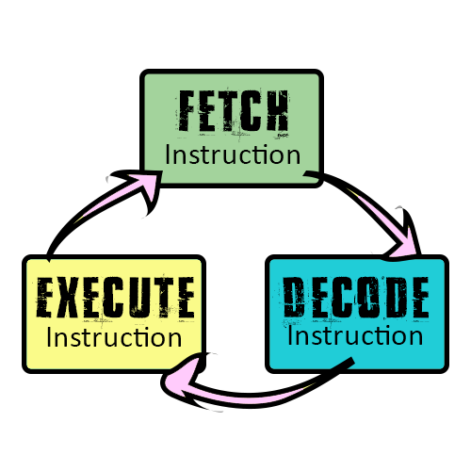
How Digital Electronic Computers Work
At a low level…
Binary only (1s and 0s), bits
The CPU…
Fetches bytes (8 bits) from memory
Decodes those bytes into instructions
Executes those instructions
Known as an Instruction Cycle.

Slide 11
But What Does This Even Mean?
At a low level…
CPU only does one computation at a time
Even multi-core processors are built on single-execution-per-cycle

Slide 12


How It Affects Programs
Things you might be running right now:
Discord
Steam
Chrome or Firefox (or Opera if you’re weird)
None of it runs exactly in parallel—they are taking turns!
The CPUs these days are just that fast.

Slide 13


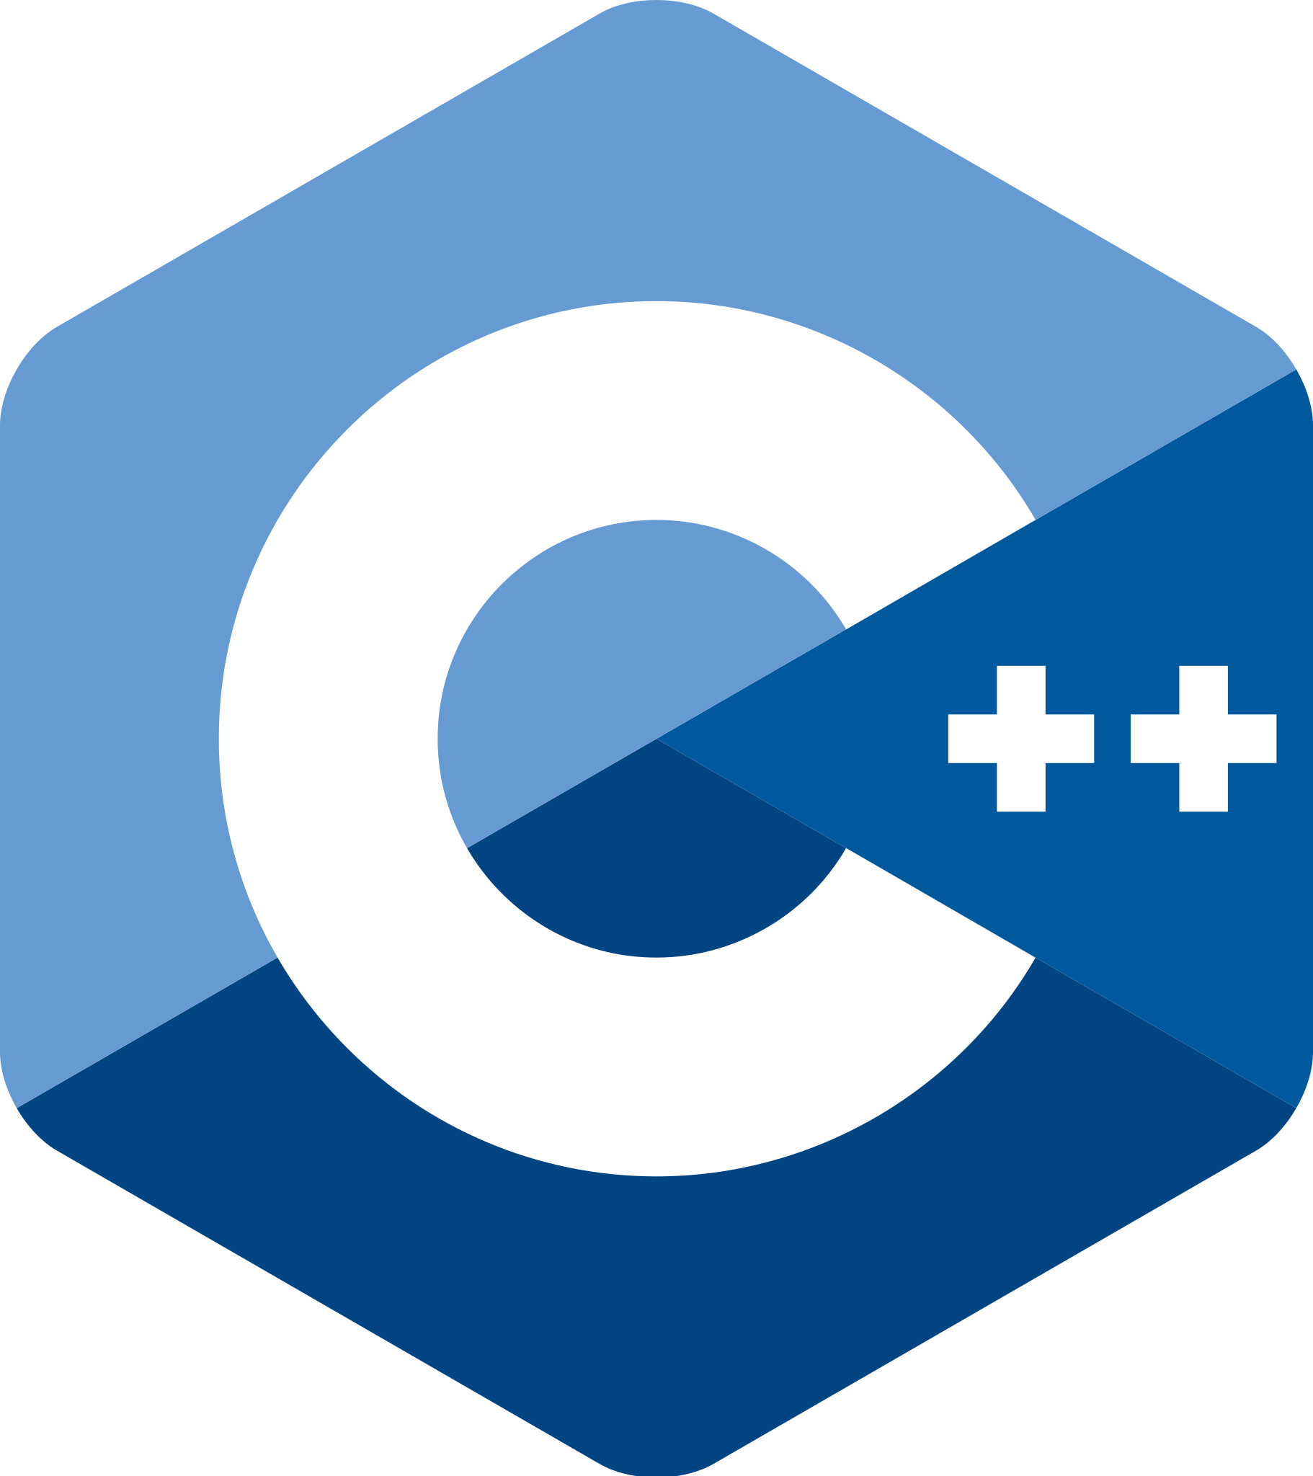
So, what are programming languages then?
They are the high-level languages of computers
They turn into machine instructions
In other words, they are a way to speak directly to your machine!

Slide 14
Which language is the best one?!?!
It is a complicated, highly debated subject matter.
In short: Use what solves your problem.
Programming paradigms transfer.
I will be using Java because it is what APCS students use.

Slide 15
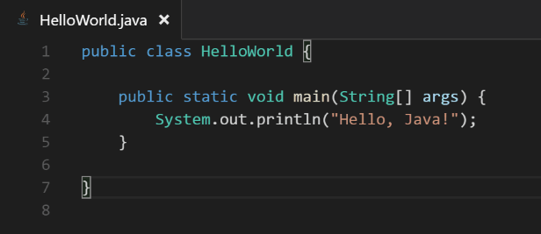
Java Structure
Class
For now, think of it as the “wrapper” of your file.
2. Main Method
Contains your instructions!!!!
3. Instructions
Here you will tell Java what you want it to do.
1
2
3

Slide 16
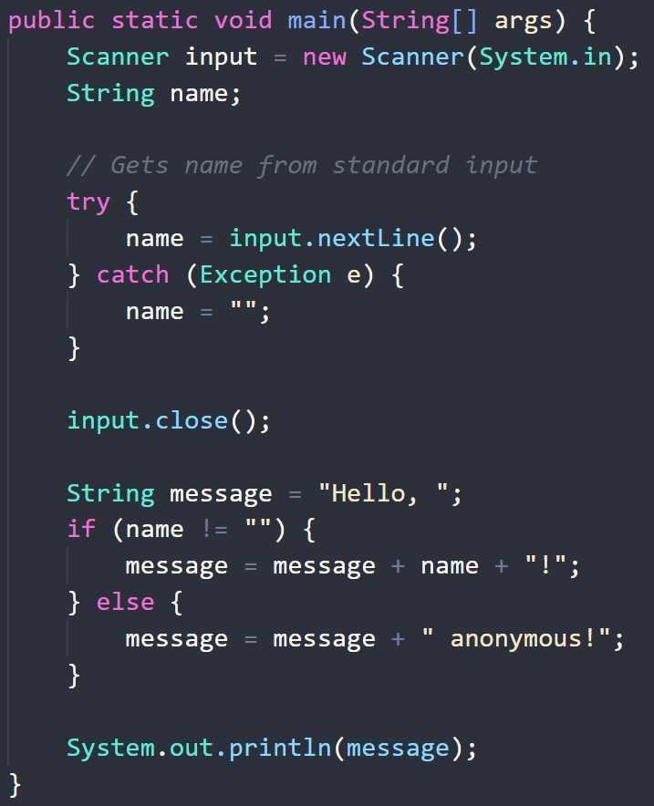
You might notice…
Reserved “key words” that do a variety of stuff
Example: public, static, void, String, Scanner, if, else
Semicolons, Curly braces, Parentheses

Slide 17
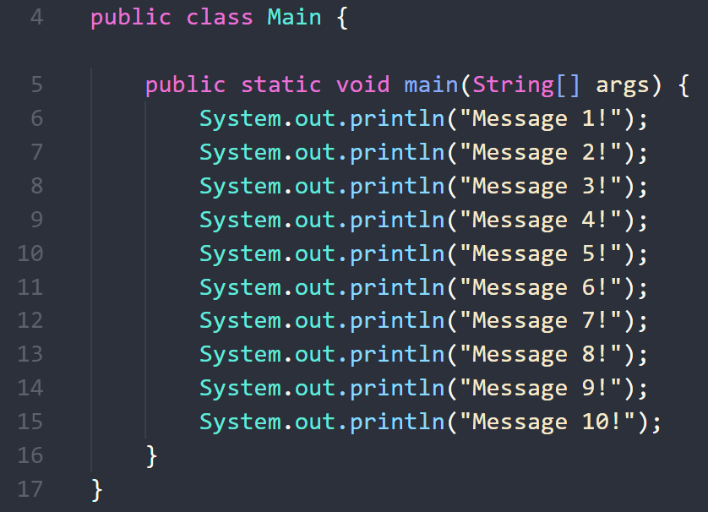
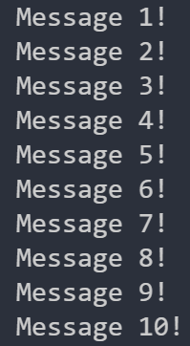
Java – Line by Line
Java instructions are performed sequentially just like in the CPU
Starting from the top of the main method, down

Slide 18
Start writing Java NOW! …But how??
Text Editors – Lightweight and Multi-purpose
Notepad, Notepad++
Sublime Text, VS Code, Atom
Integrated Development Environments (IDE) – Powerful and dedicated
NetBeans
Eclipse
IntelliJ Idea

Slide 19

For now…
We will use an online coding environment called Replit.
All you need to do is make an account on Replit and you are ready to start writing Java programs.
https://replit.com/

Slide 20

An aside on learning to program.
Do you remember the scene in SpongeBob where Patrick is trying to open the lid of a jar?

Slide 21

Programming can feel like that scene!
Computers are as smart as we make them.

Slide 22
No one writes bug-free code.
I don’t write bug-free code.
Mark Zuckerberg, Jeff Bezos, Bill Gates, Larry Page, Reed Hastings, and Tim Cook don’t write bug-free code.
You will run into many, many errors.

Slide 23
… And that’s okay!
Not understanding what is happening
Getting stuck on problems for hours on end
Googling everything
All of it is normal.

Slide 24

Bugs and Errors are not Failures.
In the process of debugging your code, you will learn a lot.
The important part is to never give up! Always keep learning.

